Slide 1
SSW-810: Software Engineering Tools and Techniques
Relational Database Technologies and Techniques
Dr. Raz Saremi
Software Engineering
School of Systems and Enterprises
This Lecture is based on material from Prof. Jim Rowland

Slide 2
Acknowledgements
This lecture includes material from:
http://www.tutorialspoint.com/dbms/
https://www.tutorialspoint.com/sqlite/sqlite_python.htm

Slide 3

Today’s topics
Database overview
Common database solutions
Have you seen my keys?
Queries
Select
Update
Delete
Defining tables
Interacting with databases from Python

Slide 4
Database Overview
Databases contain a collection of related information, organized to allow efficient access and retrieval
Several different database solutions:
Relational Database Management System (RDBMS) – data is structured in predefined tables by row and column
Object Oriented Databases – all data is represented and stored by objects
NoSQL - unstructured data is stored and processed in potentially massively parallel solutions
Source: http://www.dictionary.com/browse/object

Slide 5

Many Database Solutions

Slide 6
Why use a RDBMS?
Why not just store data in a flat file?
(Flat files may be the best solution for some problems)
Databases support:
Transaction processing/Atomicity
Multiple concurrent simultaneous users
A common query language across vendors
Data consistency enforcement
Access control

Slide 7
ACID properties
A transaction must have ACID properties
Atomic - all steps complete successfully or no change
Consistent – both successful and unsuccessful transactions must leave the system in a consistent state
Isolated – the data involved in the transaction must be isolated from other users until the transaction is complete
Durable – the changes must survive permanently

Slide 8
Transaction Atomicity
Consider a banking application where a customer transfers money from one account to another
Transfer requires two steps:
Deduct funds from first account
Deposit funds to second account
What if something goes wrong in either step?
Need to ensure that both steps are successful or the account can be left in inconsistent state
Complete both steps successfully or rollback all changes

Slide 9
Relational DBMS Characteristics
Data represents real world entities
Data stored in relational tables
Tables are analogous to spreadsheets with rows and columns
Tables may be related by “keys” which can be used to join multiple tables to find related information
Tables are designed to minimize redundant information
Use query languages (SQL) to retrieve information
Support transactions for consistency
Support multiple concurrent users

Slide 10
Example Domain
Create a database solution
Start up company has employees and projects
Track who’s working on which projects

Slide 11
Entity Relationship Model
Entities represent some physical or logical object
E.g. employee, manager, project …
Entities may have attributes
An employee has an ID number and a title
A project may have a set of employees
Keys are attributes that uniquely identify one instance of an entity from other instances
e.g. an employee ID uniquely identifies each employee

Slide 12
Entity Relationship Models
Emp_ID
Name
Project
Emp_ID
Employee
Member
many
many
Project
Title
Salary
Employees Table
Projects Table
Emp_ID | Name | Title | Salary
123 | Nanda | Developer | 80000
234 | Sujit | Tester | 70000
345 | Jim | Manager | 85000
Project | Emp_ID
OnlineBanking | 123
GameConsole | 234
OnlineBanking | 234

Slide 13
Representing Entities in a Relational DB
Entities are typically represented in tables
Attributes are represented as columns in the table
Instances are represented as tuples (rows) in the table
Tables may include a primary key to uniquely identify the instance of the entity represented by the tuple/row
Employees Table
Projects Table
Emp_ID (Key) | Name | Title | Salary
123 | Nanda | Developer | 80000
234 | Sujit | Tester | 70000
345 | Jim | Manager | 85000
Project | Emp_ID
OnlineBanking | 123
GameConsole | 234
OnlineBanking | 234

Slide 14


Database Tools
Many different tools to work with databases
Create and explore tables
Write and run queries

Slide 15
Database operations
Command | Semantics
Create | Create a database, table, or view
Drop | Drop a database, table, or view
Alter | Modify the database schema
Insert | Insert new records into the table
Update | Update one or more attributes in an existing record
Delete | Delete one or more rows from a table
Select | Select a subset of records from the table based on selection criteria

Slide 16
SQLite is a small, open source, file-based RDBMS
Download from https://sqlite.org/download.html
Choose the precompiled binaries for your laptop
Works with files or in memory databases
Create a new database
$ cd 810/assignments
$ sqlite3
Connected to a transient in-memory database.
sqlite> .save 810_startup.db
sqlite> .exit
Or create database in DataGrip
SQLite supports in-memory and on disk databases
Create a SQLite database file in 810_startup.db

Slide 17
DataGrip Features
Connect to many different relational databases
SQLite, Oracle, MySql, PostgreSQL…
GUI automates many common tasks
Create a new database file
Table definition
Create data table from file
Save query output to a text file
Auto completion for table names and attributes
Free download for academic use
Part of the JetBrains product line, including PyCharm

Slide 18
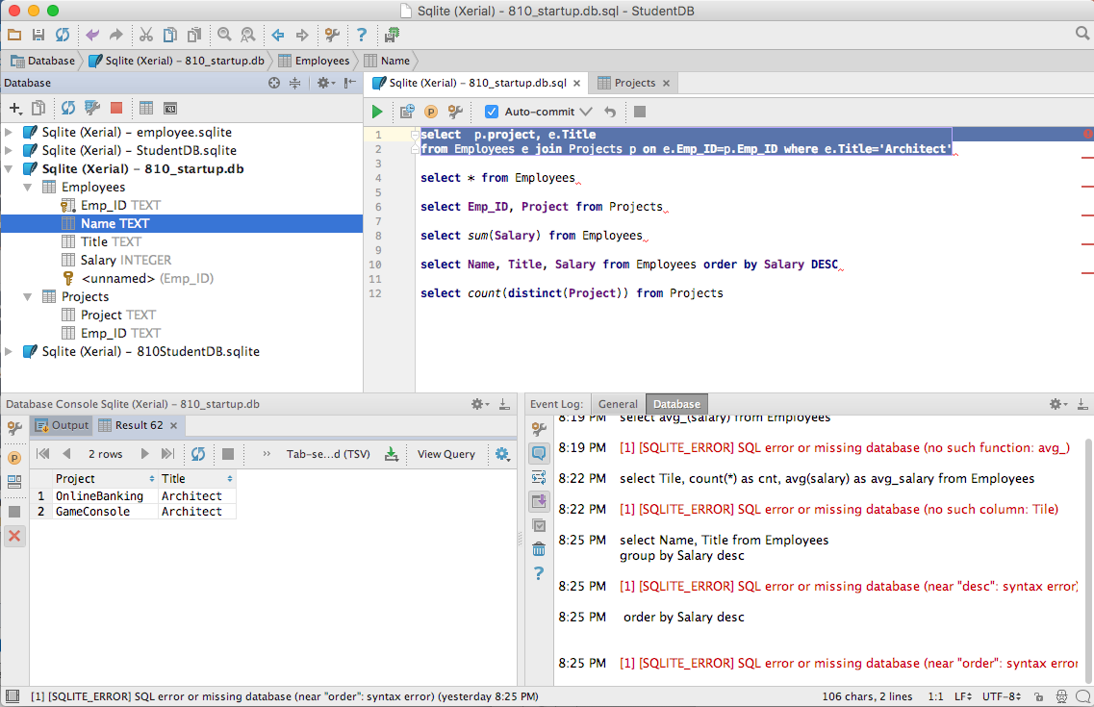
JetBrains DataGrip
Explore table definitions
Write and execute queries
General information
See query outputs

Slide 19
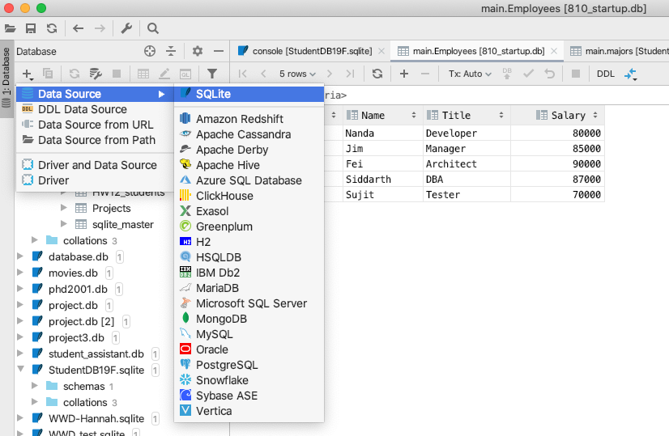
Create a new database in DataGrip
Choose ‘New’
Choose ’SQLite’

Slide 20
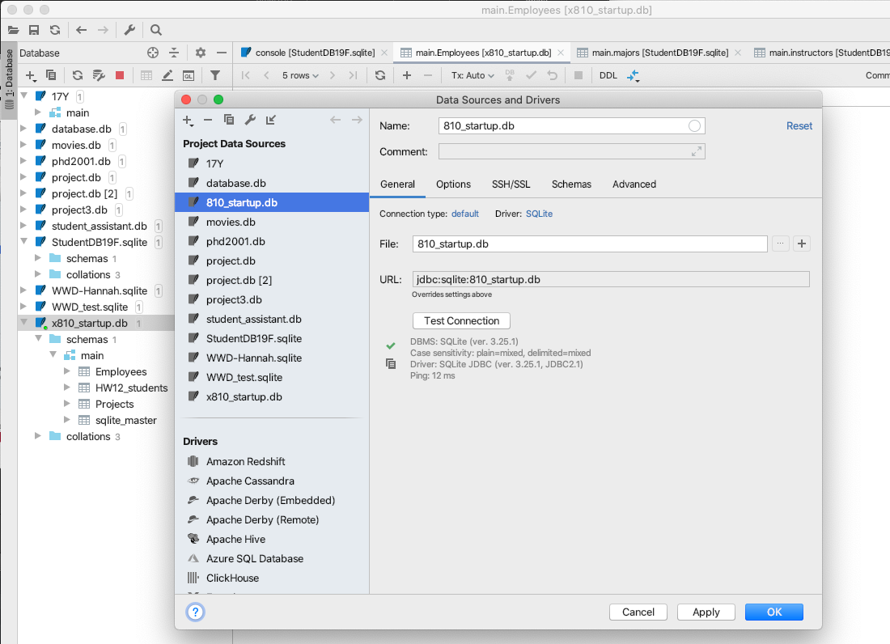
Create a new database in DataGrip
1. Specify a directory and filename
2. Test the new database connection

Slide 21
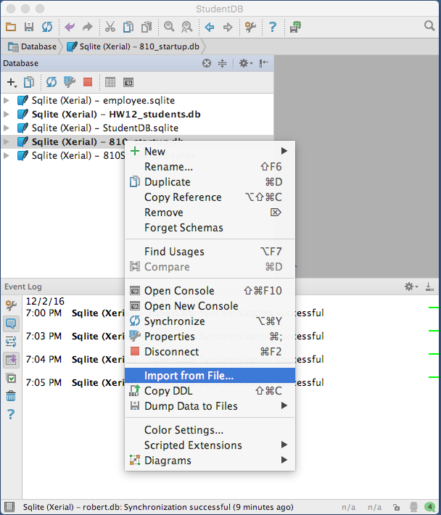
DataGrip: Import a file into a table
Right click on your database file
Choose “Import from File…”

Slide 22
Create a new table
Specify:
The table name
Each attribute in the table
The data type of each attribute in the table:
INTEGER, REAL, TEXT, BLOB
Optional constraints on attributes
NOT NULL
PRIMARY KEY
FOREIGN KEY
DBMS may support different types

Slide 23
Create Table SQL Examples
CREATE TABLE Employee(
Emp_ID TEXT PRIMARY KEY NOT NULL,
Name TEXT,
Title TEXT,
Salary REAL
)
CREATE TABLE Project (
Project TEXT PRIMARY KEY NOT NULL,
Emp_ID TEXT
)
Primary Keys uniquely identify an entity
NOT NULL adds a constraint to the value

Slide 24
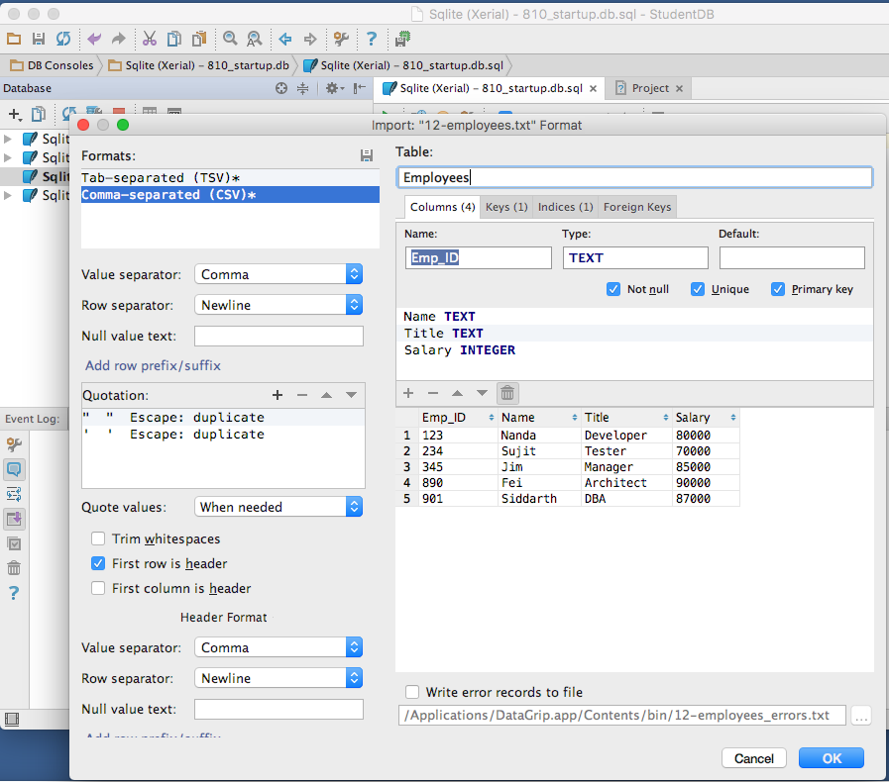
Create a new table from a data file
Choose a name for the new table
DataGrip only allows comma, semicolon or tab separators
Adjust name and type
The data to import
Optionally read column names from the file

Slide 25
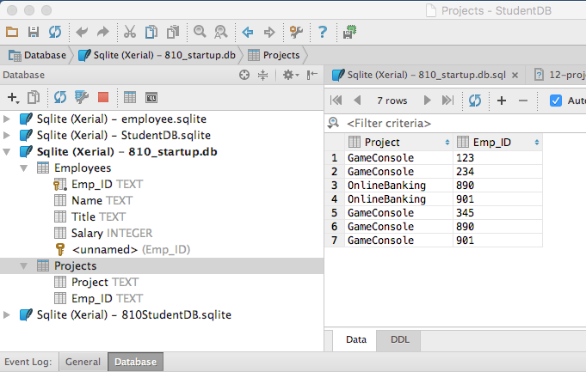
Repeat for Projects Table
Employees Table
Projects Table
Projects data

Slide 26
Insert records
Insert a single row
INSERT into <TableName> [(column_name, …) ]
VALUES (<value1>, <value2>, …);
INSERT into Employees (Emp_ID, Name, Title)
VALUES (123, ‘Nanda’, ‘Developer’)
Insert rows from a select query
INSERT into <TableName> (<ColumnNames)
SELECT <Columns> from <Table1>

Slide 27
Alter Table
Change the name of a table
Change the features of a table
Add/drop attributes
Change data type of an attribute

Slide 28
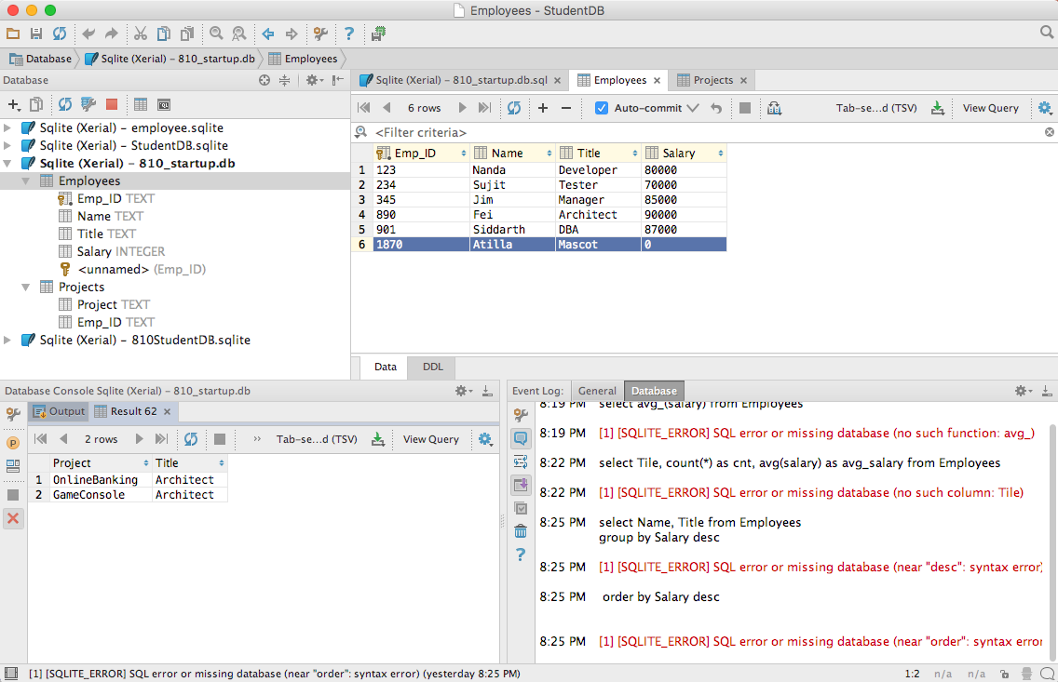
Delete rows from a table
delete from <table> where <condition>
delete from Employee where Title=‘Mascot’
All rows matching the criteria will be deleted
Choose a row and hit CMD/CTRL <delete>

Slide 29
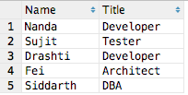
Select queries
Select chooses a set of rows and columns from one or more tables
SELECT column₁, …, column_{n} FROM table
select Name, Title from Employees
Select returns a result table

Slide 30
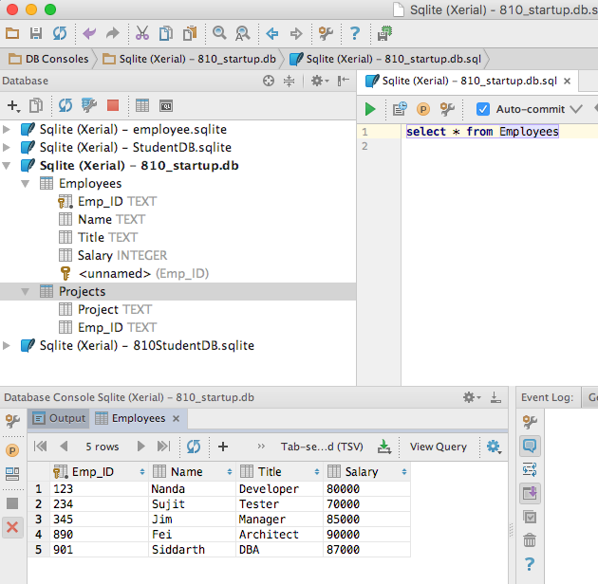
Select with DataGrip
If you don’t see a ”green button”…
…Right click on your database name and select “open console”
Query results appear here

Slide 31
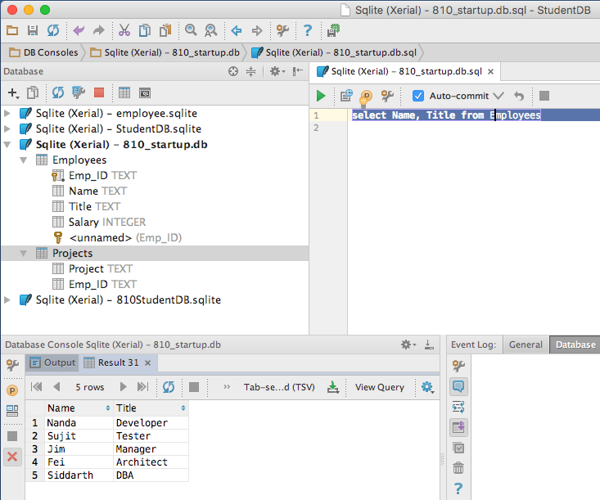
Select with DataGrip
Write the query, then click the “go” icon
Highlight your select statement
Results appear here

Slide 32
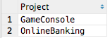
Special SELECT alternatives
SELECT * from <Table>
Select all rows from <Table>
SELECT COUNT(*) FROM <Table>
Select the number of rows in <Table>
SELECT DISTINCT column₁ FROM <Table>
Select all distinct values of column₁ from <Table>
SELECT DISTINCT(Project) FROM Projects

Slide 33
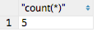
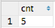
Select Aliases
Change the label in the results of a SELECT query
SELECT COUNT(*) FROM Employees
SELECT COUNT(*) AS cnt FROM Employees

Slide 34
Aggregate functions
Useful aggregate functions for SELECT
Aggregate Function | Returns
AVG(<COLUMN>) | Average of the specified column
COUNT(<COLUMN>) | Number of non-NULL values in the column
COUNT(*) | Number of rows in the table
MAX(<COLUMN>) | Maximum value the specified column
MIN(<COLUMN>) | Minimum value in the specified column
SUM(<COLUMN>) | Sum of the specified column

Slide 35
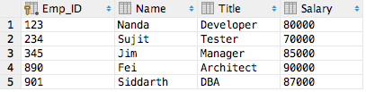
Aggregate functions
Employees Table
Query | Result
select avg(salary) from Employees | 82400
select count(Title) from Employees | 5
select count(*) from Employees | 5
select max(Title) from Employees | Tester
select min(Name) from Employees | Fei
select sum(Salary) from Employees | 412000

Slide 36
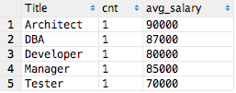
Aggregate functions and GROUP BY
SELECT <COLUMNS> GROUP BY <COLUMNS>
Groups the common values together
select Title, count(*) as cnt, avg(Salary) as avg_salary from Employees group by Title
Group the rows by Title when computing aggregates

Slide 37
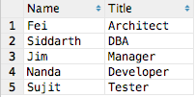
Select ORDER BY
SELECT <COLUMNS> ORDER BY <COLUMNS> [ASC | DESC]
Orders the output table by the specified columns
select Name, Title from Employees order by Salary DESC
Order the rows in descending order by salary

Slide 38
Select Where
Select a set of rows and columns from one or more tables that meet the specified criteria
SELECT column₁, …, column_{n}
FROM table
WHERE column <operator> <value>
Operators include =, !=, <>, >, <, >=, <=, !<, !>
select name, Title from Employees
where name = ‘Jim’
select * from Employees
where salary >= 70000
Select returns a result table

Slide 39
Data Normalization
Database tables are designed for efficiency
Eliminate redundant data – store it once
Save space
Make changes easier because the data is stored only once
Project Example
Employee: Name, Title, Salary
Project: Project, Employees assigned to that project

Slide 40
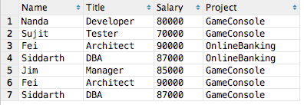
Option 1 – (not a great solution)
Represent all data in a single table (“Excel Solution”)
What happens if Fei is promoted from Architect to Chief Architect and gets a raise?
Must find and update all relevant rows or the data will be inconsistent
Must find and update all relevant records consistently

Slide 41
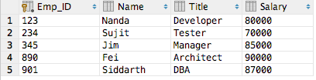
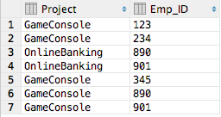
Option 2 - Store each item once
Employees
Projects
Any change in Employees or Projects requires only one change
But how to see the tables together???

Slide 42

Joins
Data is frequently stored in multiple tables
Use keys to join multiple related tables
Primary Key
One or more columns
Uniquely identifies a row in a table
Foreign Key
Refers to a Primary Key in a different table
Used to join tables
Not all tables have keys but we can join on any field

Slide 43
Option 2 - Store each item once
Employees
Projects
Any change in Employees or Projects requires only one change
But how to combine the data across tables???

Slide 44
Join
Joining tables on primary/foreign keys allows us to combine fields from relevant tables
SELECT <columns>
FROM
<TABLE1> <ALIAS1>
JOIN <TABLE2> <ALIAS2>
ON <ALIAS1>.<COLUMN> = <ALIAS2>.<COLUMN>
JOIN <TABLE3> <ALIAS3>
ON <ALIAS1>.<COLUMN> = <ALIAS3>.<COLUMN>
Join returns a result table with all of the rows meeting the constraints
Join across as many tables as needed
Join as many tables as needed

Slide 45
Option 2 - Store each item once
Employees
Primary Key
Projects
Foreign Key
Primary/Foreign Keys relate records from different tables

Slide 46
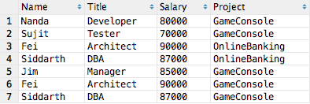
Option 2 - Store each item once
Employees
Projects
select e.Name, e.Title, e.Salary, p.Project from Employees e
join Projects p on e.Emp_ID=p.Emp_ID
Employees joined with Projects

Slide 47
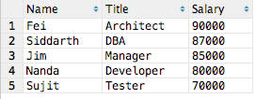
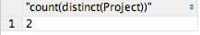
Answering questions with queries
Who is the highest paid employee?
select Name, Title, Salary
from Employees order by Salary DESC
How many projects?
select count(distinct(Project)) from Projects

Slide 48
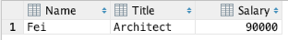
Answering questions with queries
Who is the highest paid employee?
select Name, Title, Salary
from Employees order by Salary DESC limit 1
How many projects?
select count(distinct(Project)) from Projects
Limit output to 1 row

Slide 49
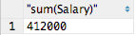
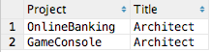
Answering questions with queries
What is the total salary for all employees?
select sum(Salary) from Employees
Which projects have an Architect?
select p.Project, e.Title from Employees e
join Projects p on e.Emp_ID=p.Emp_ID
where e.Title='Architect'

Slide 50
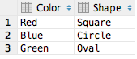
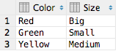
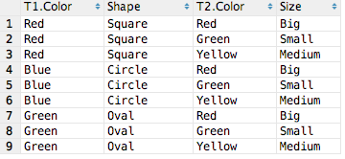
Other types of queries: Join
T1
T2
select * from T1 join T2 (No qualifications)
→ Full cross product of all combinations
T1
T2

Slide 51
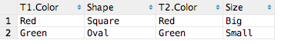
Other types of queries: Join on
T1
T2
select * from T1 join T2 on T1.Color = T2.Color
(aka inner join)
→ Only rows from T1 and T2 where T1.Color = T2.Color
T1
T2

Slide 52
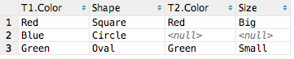
Other types of queries: Left Join
T1
T2
select * from T1 left join T2 on T1.Color = T2.Color
All rows from T1 and matching rows from T2 where T1.Color = T2. Color
T1
T2

Slide 53
Accessing Databases with Python
Python provides APIs to interact with databases
Approaches:
Database specific APIs using module for each database
SQLAlchemy
Add a logical layer between Python code and the database
Object Relational Manager (ORM)
Python
SQLAlchemy
Object Relational Manager (ORM)

Slide 54
Python Database APIs
Action | Semantics
Connect | Open a connection to the database
Create | Create tables, insert rows
Read | Select rows
Update | Update existing table rows
Delete | Delete existing table rows
Commit | Commit transaction changes
Roll back | Undo changes since last commit
Close | Close the database connection

Slide 55
Database Operations and Python APIs
Commit
Connect to Database
Execute Queries
Close Database
Rollback

Slide 56
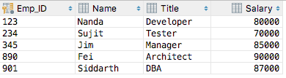
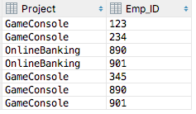
Start-up company sample database
Employees Table
Projects Table

Slide 57
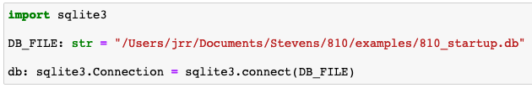
Connect
SQLite supports both memory and file-based databases
connect(path) opens the database at path or in memory if path == ‘:memory:’
Beware: SQLite creates a new database file if you specify a non-existent file

Slide 58
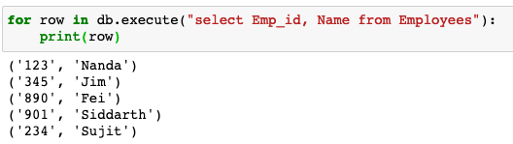
Select queries
Execute arbitrary queries
Execute(query)returns a sequence of tuples with the rows from the query

Slide 59
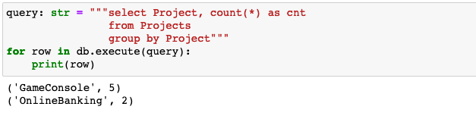
Select queries
Execute any valid query, including aggregations

Slide 60
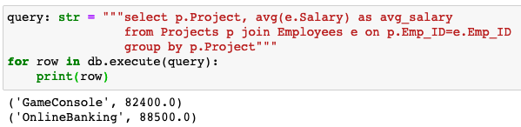
Select queries
Execute any valid query, including joins, group by, etc.
Write and test queries in DataGrip then copy the SQL to Python

Slide 61
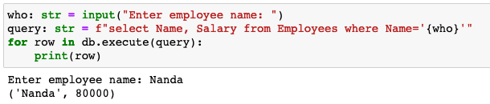
Parameterized queries
How to add a parameter to a query?
The query is just a string, so create a string to represent the query
What could possibly go wrong?
Simple, but wrong… and dangerous…

Slide 62
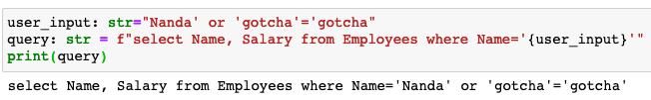
SQL Injection Attacks
Scenario:
A bad actor is authorized to see only his own salary but wants to know all salaries
A naïve developer concatenates user input as part of the query
The bad actor injects extra SQL in the input to change the query
Matches ALL rows

Slide 63
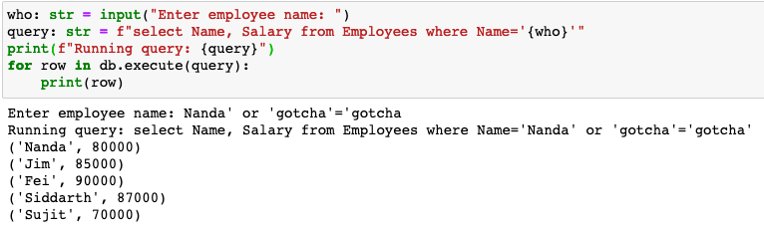
SQL Injection Attack on Parameterized Query
Looks okay, right???
Bad actor changed the query from input
WAIT!!!
That’s not what we intended!
Results from ALL employees

Slide 64
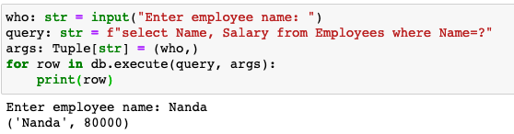
Preventing SQL Injection Attack on Parameterized Query
Include ‘?’ in the query for each parameter and pass the parameters separately as a tuple
execute checks the parameters to prevent SQL Injection attacks
Specify ‘?’ in the query for each parameter
Pass the arguments to execute() as a tuple

Slide 65
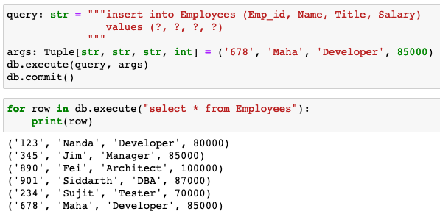
Insert queries
Insert rows into tables using computed values
The new row won’t appear in queries until commit()
The new row

Slide 66
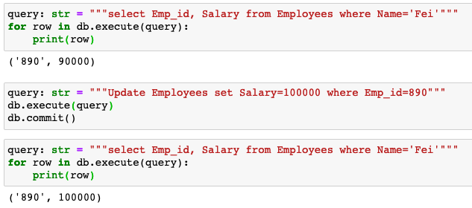
Update queries
Fei earned a raise
The new row won’t appear in queries until commit()
The updated row

Slide 67
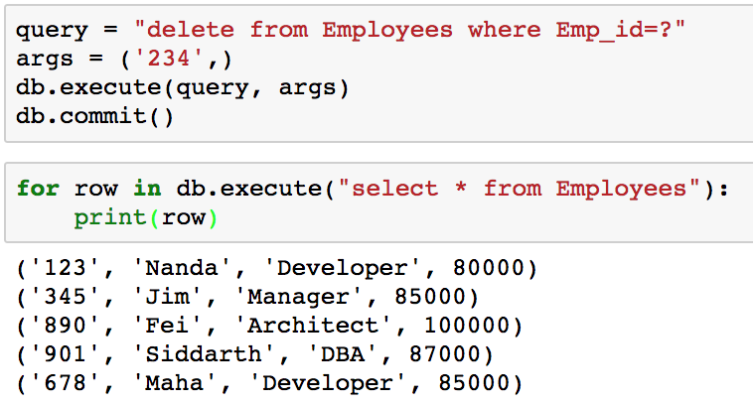
Delete queries
Emp_ID 234 has been deleted

Slide 68
Close
Use close() to close the connection to the database

Slide 69
SQLite Python API Summary
Action | Semantics
Connect | Open a connection to the database
Create | Create tables, insert rows
Read | Select rows
Update | Update existing table rows
Delete | Delete existing table rows
Commit | Commit transaction changes
Roll back | Undo changes since last commit
Close | Close the database connection

Slide 70

Questions?

Slide 71

Today’s topics
Decorators
Encapsulation
@property, @attribute.setter
Polymorphism
Dynamic typing with Duck Typing
Class attributes
Static methods

Slide 72


Encapsulation/Information Hiding: Public vs Private interfaces in classes
 | Public Interfaces | Private Interfaces
Sharing | Shared freely with other modules | Not shared: details are hidden
Used by others | Safely used by other modules without concern of changes | Not available to other classes
Cost of change | New interfaces are cheap but changes may be very expensive if the change breaks other modules | Class implementation may change without impacting other modules

Slide 73
What are we hiding from whom and why?
What?
Attributes and methods critical to the proper behavior of the class
Design decisions, e.g. critical data structures
From whom?
Programmers (including the class author) with access to code
Data privacy is not relevant because the code is available
Subclasses derived from the superclass
Why?
Improve encapsulation to allow the internal implementation to change without impacting the public interfaces used by other code

Slide 74
Private/Protected attributes/methods
Java and C++ enforce public, protected, and private in the compiler
Python assumes that we’re all responsible adults and everyone will follow the Python conventions:
name (no _) tells the reader that name is public
_name (single _) tells the reader that _name is protected
__name (double _ ) tells the reader that __name is private and shouldn’t be used outside the class definition

Slide 75
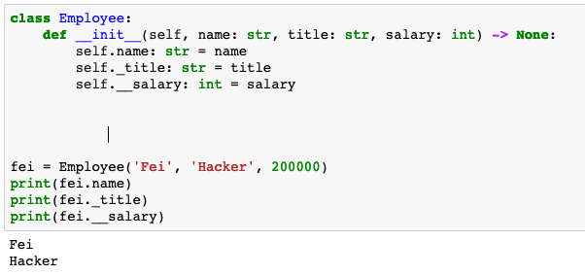
Private/Protected in Python
name tells the reader that name is public
_name tells reader that _name is protected only by convention
__name tells reader that __name is private only by convention
self.attr is public by convention
self._attr is protected by convention
self.__attr is private by convention
Public and Protected attrs can be used as expected
Private attrs are hidden by name mangling

Slide 76
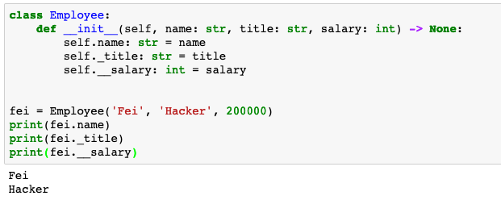
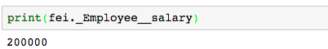
Private/Protected in Python
Don’t rely on private to protect sensitive information
Anyone with access to the code can still see all the details

Slide 77
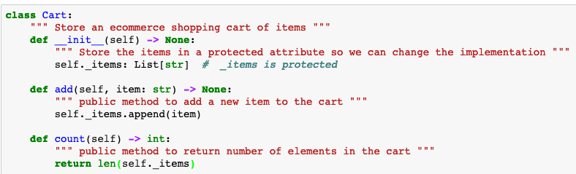
Private/Protected in Python
Use protected to warn readers not to rely on specific implementation details but most attributes are public
The implementation may change so don’t rely on protected attributes
It’s safe for other code to use public attributes and methods
add() and count() are public methods

Slide 78
e-Commerce Shopping Cart Item
Class Item:
Attributes
name
price
quantity
Methods
cost()
__str__()
Public so other code is free to assume that these interfaces will always be supported. The interfaces won’t change.
Public so other code is free to assume that these interfaces will always be supported. The interfaces won’t change.

Slide 79
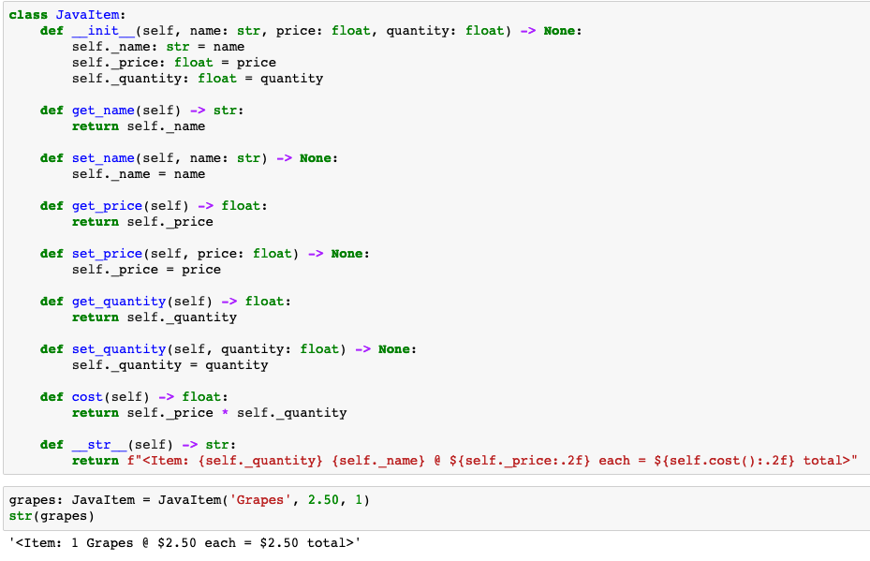
Java-inspired Item class methods
Getter()/Setter methods defined for all attributes
Pythonistas cringe at all the extra code to read and maintain

Slide 80
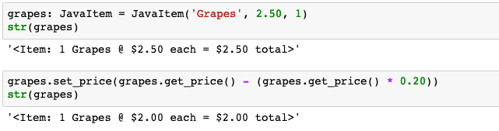
Adjust price to include 20% discount
Getters/Setters provide encapsulation at the cost of concise, readable code

Slide 81
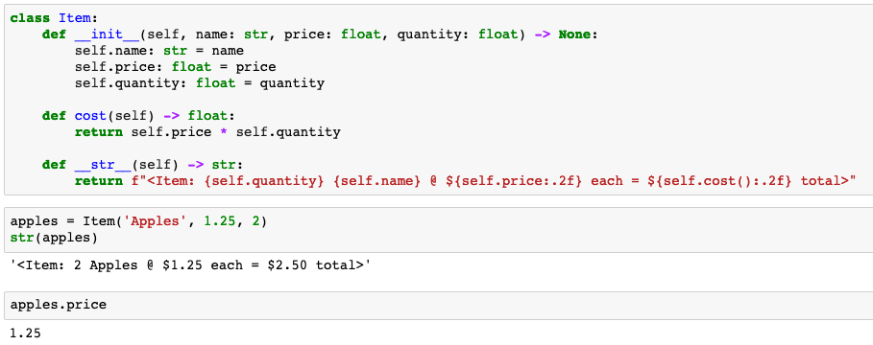
Pythonic Item class
name, price, and quantity are public
cost() is public
All attributes are available with object.attribute notation

Slide 82


Discounting the price of Items
Getters/Setters provide encapsulation at the cost of concise code
Which is easier to read and maintain?
Which is easier to read and maintain?

Slide 83

Encapsulation is a good thing…
Our class Item code is very popular and is widely reused in many projects
Developers have code using object.attribute notation
…BUT THEN…
Unscrupulous customers discover that negative quantities lead to refunds
This happened to Amazon.com
Oops! We owe money to the customer for buying apples!?!

Slide 84
Encapsulation is a good thing…
We need to guard the quantity attribute against negative values
… maybe getters/setters aren’t such a bad idea
… but, getters/setters bloat the code
… worse yet, other projects have existing code using object.attribute notation
We can’t expect everyone to change all references throughout their code
What’s a Pythonista to do???
Hint: we’re not converting to Java
Hint: maybe decorators can help!

Slide 85
@property, @setter
Python discourages getter/setter functions for attributes
Instead, Python encourages obj.attribute notation both for getting and setting attributes
What if you need extra logic around a getter or setter?
e.g. check for a valid range before returning or setting value
@property/@setter allows you to define a property of a class which is a function wrapper for an attribute’s getter and setter with extra functionality
Execute extra code while allowing users to use obj.attribute notation for getting/setting values

Slide 86

Changing quantity to an @property
Let’s change the semantics of Item.quantity to a function that checks for quantity < 0

Slide 87

Getting Item.quantity with @property
Make _quantity protected
@property adds a read-only getter that is invoked when Item.quantity is accessed
We can still reference self.quantity and Python calls self.quantity()
Quantity < 0 is 0
Quantity < 0 is 0

Slide 88

What if we need a setter()?
@property decorator defines a new read-only attribute that can be accessed with dot notation
What if we need to set the value?
Oops!!!

Slide 89

Adding a setter()
@name.setter decorator adds a method to set the value of name that can be accessed with dot notation

Slide 90

Using the setter()
@quantity.setter causes Item.quantity(self, num) to be called on assignment
The legacy 20% discount code using dot notation still works without change

Slide 91
@property/@attribute.setter review
We defined class Item with public attributes
Our code and code from others used dot notation to access the public attributes
We needed to change the class without breaking backward compatibility of dot notation
@property allows us to define a method to an attribute that is invokes when the value is retrieved
@attribute.setter allows to add an optional setter method

Slide 92
Questions?

